Slide 1


Slide 2
CSCI 440 - Database Systems
Instructor: Carson Gross
carson.gross@montana.edu

Slide 3
Course Goals
To give you a broad understanding of relational databases
To help you become proficient in SQL
To help you be confident in schema design
Enable you to work with databases in code (Java)
Learn a bit of database theory and implementation
Learn about some non-relational modern tools
NoSQL
Cloud Architectures

Slide 4
Instructor Introduction
My name Carson Gross
Recently arrived from Northern California
Academic Background
BS in IE/OR from Berkeley (I dropped out of CS)
MS in CS from Stanford
Career
Interned at Google
Staff Engineer at Guidewire Software
Gosu Programming Language
Founder/CTO at LeadDyno
Creator of many open source projects
http://intercoolerjs.org
https://htmx.org
https://hyperscript.org

Slide 5
Classroom Mechanics
Lectures are at 11AM, MWF in Ried 105
All lectures will be live streamed via YouTube
TA will monitor chat room for questions during live streams
You do NOT need to attend this class in person if you have health concerns. All assignments, lectures and tests will be available online

Slide 6
Grading
Individual Programming Assignment - 70%
Quizzes - 10%
Home works - 20%

Slide 7
Programming Assignment
The programming assignment will be a classic web CRUD application
Tied to two different types of databases
A SQLite database for primary data
A Redis database for caching
Done individually (I want you to learn) and graded primarily with an autograder via tests
Good introduction to Test Driven Development

Slide 8
Quizzes
This class has no midterm or final
Instead, we will have quizzes on the Friday of every even week
The quizzes will be done online via D2L
Open everything, but please do not communicate with other students
A small portion of your grade, it’s not worth risking getting caught cheating, which will be an auto-fail
Quizzes will start easy and get harder over time

Slide 9
Homeworks
There will be three homework assignments during the class
Generally they are oriented towards writing practical SQL
Graded the same way we grade the project
More variable than the project (which can be a little repetitive, but that’s realistic!)

Slide 10
Autograding
I have created an autograding system
I will run auto-grades occasionally during the lifetime of assignments
The autograde system pushes the results up to your github repository (More on this later)
This means you will be able to see your results in your /grades folder
No surprises!

Slide 11
Discord
Discord has proven to be an excellent way to communicate with students
Please join the MSU discord!
A link can be found on the “Content” page in D2L
Join the 440 group with the command !join-440

Slide 12
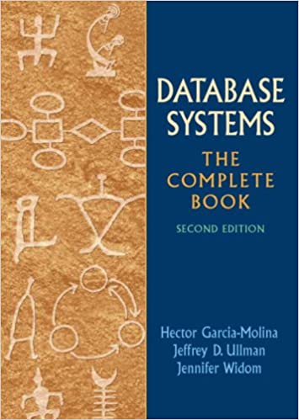
Book
Database Systems
The Complete Book
Notes:
Can be found online… but I can’t link to it

Slide 13
NB: I’m not a huge fan of this book
To be honest, you can probably get through the class without buying it
A better resource: https://www.sqlitetutorial.net/
Notes:
Can be found online… but I can’t link to it

Slide 14
Course Outline
Introduction
E/R Data Modelling
The Relational Model
SQL
SQL & The Web
Database Management
Theory & Implementation
NoSQL
Cloud Concepts

Slide 15
Introduction
An Overview of Database Systems
Understanding Git & Github
Not DB, but necessary for the class project and homeworks
Using Database Tools in IntelliJ

Slide 16
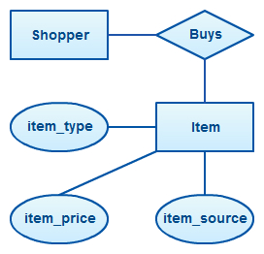
E/R Data Modeling
Visual design of databases
Used to some extent in industry
Not as much as some professors might think though
A gentle introduction to data modeling
Notes:
Can be found online… but I can’t link to it

Slide 17
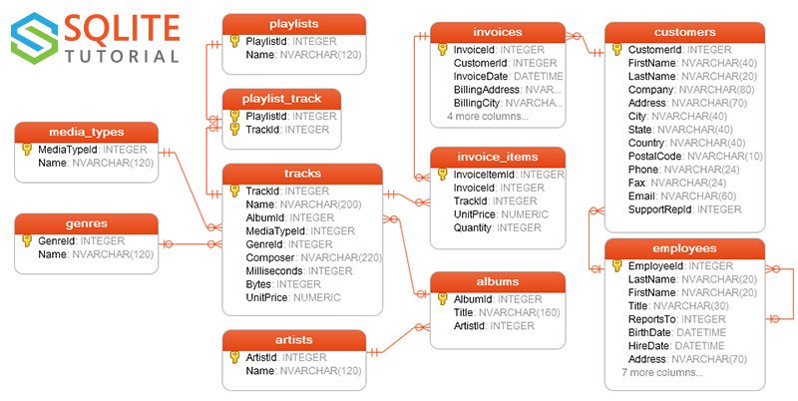
The Relational Model
Develop an understanding of relations and the relational model
Understand how E/R diagrams map to relations
Discuss how polymorphism (Object Oriented Data) can be handled at the relation level
Notes:
Can be found online… but I can’t link to it

Slide 18

SQL
The best part of the course!
SQL - Structured Query Language
It’s a programming language!
The most successful declarative programming language in history?
Maybe Excel?
Used universally in industry and government
Notes:
Can be found online… but I can’t link to it

Slide 19



SQL & The Web
SQL by itself is useful
SQL tied to a web server…
Maybe 75+% of startups?
We will be using Java
Very good database tools
Easy enough to program in
IntelliJ has good database tools
Stack:
SparkJava
ActiveJDBC
SQLIte
Notes:
Can be found online… but I can’t link to it

Slide 20

Database Management
Creating & modifying databases
Transaction management
Making databases run fast
Notes:
Can be found online… but I can’t link to it

Slide 21
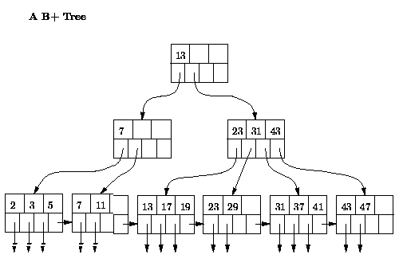
Theory & Implementation
Some light theory
Relational Algebra
Relational Calculus
Learn how B-Trees work
B-Trees are used in lots of applications, it’s worth learning about them
Notes:
Can be found online… but I can’t link to it

Slide 22


Non-Relational Tools
Relatively recent development (late aughts)
Databases that do not use the relational model
Often use JSON
We will focus on the biggest two:
MongoDB
Redis
Notes:
Can be found online… but I can’t link to it

Slide 23



Cloud Concepts
Most applications today are deployed in a Cloud
e.g. Amazon’s AWS
Overview of typical architectures
Concepts
Clustering
Sharding

Slide 24
Cheating
Don't
Seriously, you are only cheating yourself. You will need to interview to get a job & you don't want to embarrass yourself
What's OK:
Discuss programming assignments (not answers) with other people
Helping other people debug (not write) their program
What's Not:
Share code with other people
Submit code that you did not write (small snippets from StackOverflow OK)
Modify someone else's solution and claim it as your own

Slide 25


Slide 26
Homework 0
Install IntelliJ
Student licenses are available
Set up your Github repository
Head to https://github.com/msu/csci-440-fall2021
Follow the instructions under “Getting Your Private Copy”

Slide 27
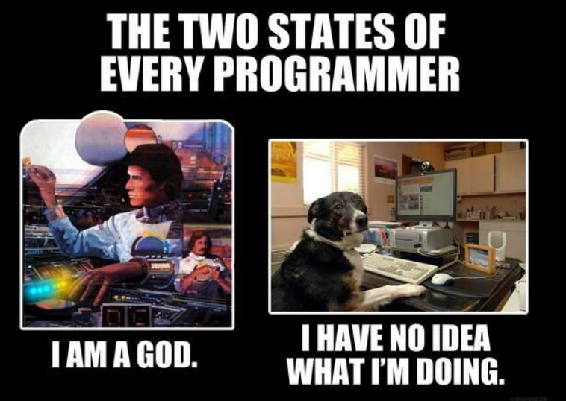

Slide 28
ME, MOST OF THE TIME

